Slide 1

Project Testing
Manual & Automation
TEAM IQ

Slide 2

About Us
Project comprises of two phases:
Automation testing on LMS website.
Manual testing on ATM Console based application.
TEAM IQ – Began on 18th of April, We've been on a mission to test all kind of websites and application.

Slide 3

LMS Automation
Automation
Tested Based on Page Object Model
Page Object Model in Selenium WebDriver is an Object Repository design pattern.
Page Factory is an optimized way to create object repository in Page Object Model framework concept.
Selenium page object model creates our testing code maintainable, reusable.

Slide 4
Page Object Model:
Page Object Model (POM) is a design pattern, popularly used in test automation that creates Object Repository for web UI elements.
The advantage of the model is that it reduces code duplication and improves test maintenance.
Under this model, for each web page in the application, there should be a corresponding Page Class. This Page class will identify the WebElements of that web page and also contains Page methods which perform operations on those WebElements.
This design pattern can be used with any kind of framework like keyword-driven, Data-driven, hybrid framework, etc.

Slide 5
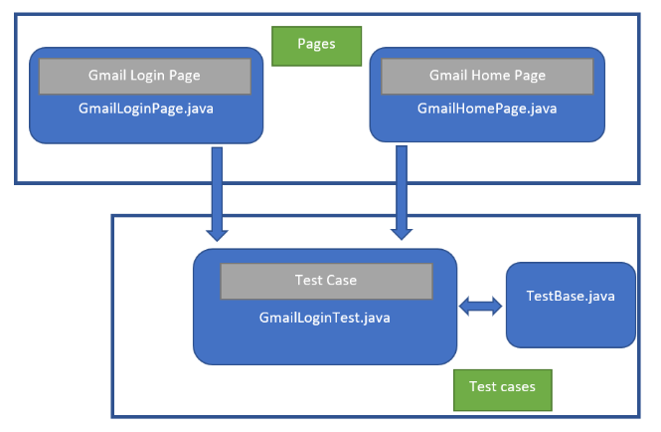
Page Object Model Design Pattern:

Slide 6
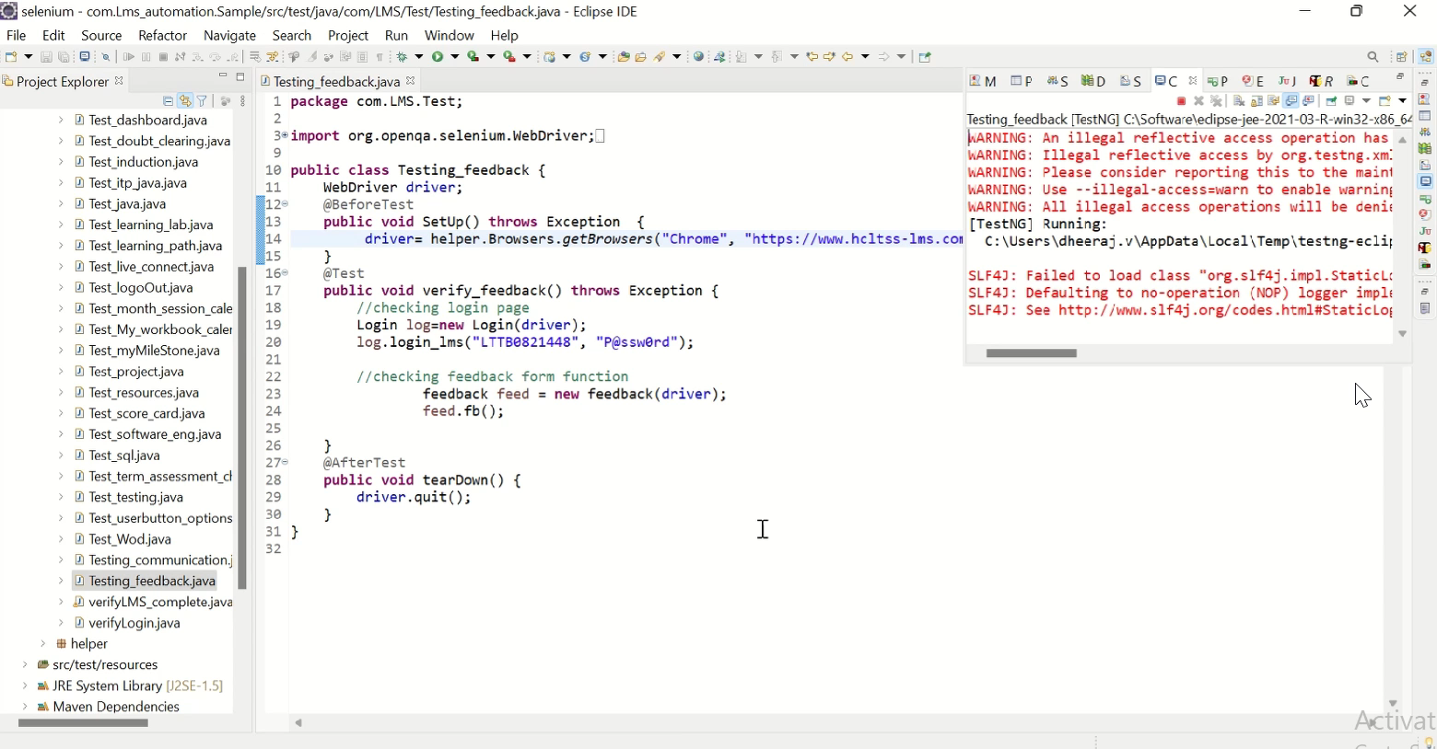
Workflow of LMS Functions:
Testing of all the functions in LMS

Slide 7
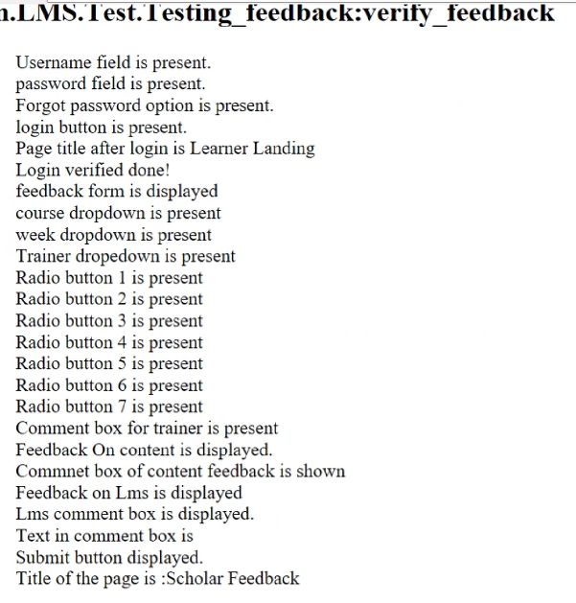
Test Report of Function
Feedback Form

Slide 8
Testing of Complete LMS
Using Automation
Will Shown at the End of PPT

Slide 9
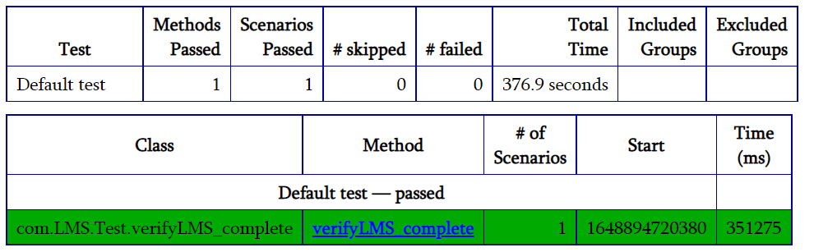
Test Report:

Slide 10
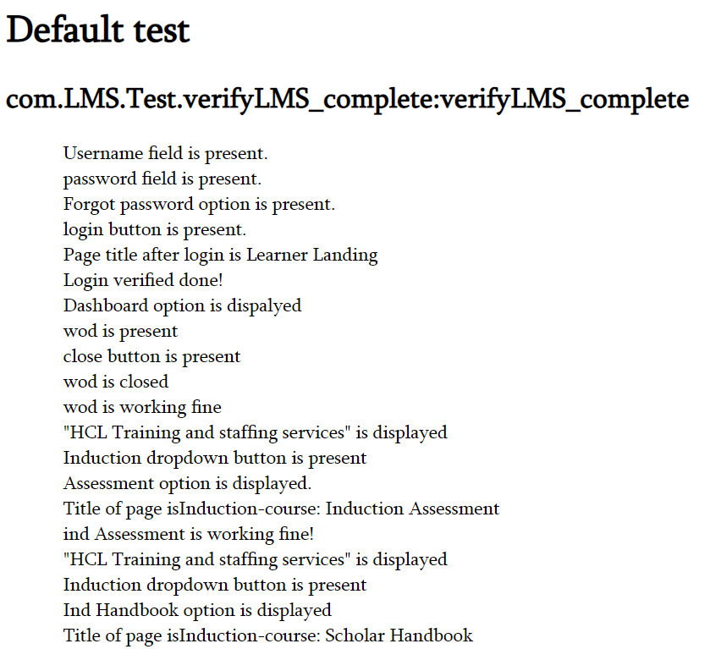
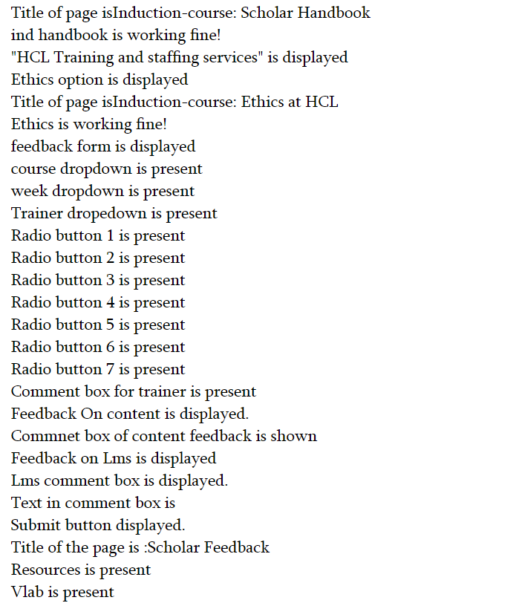
Functionalities Test Report:

Slide 11
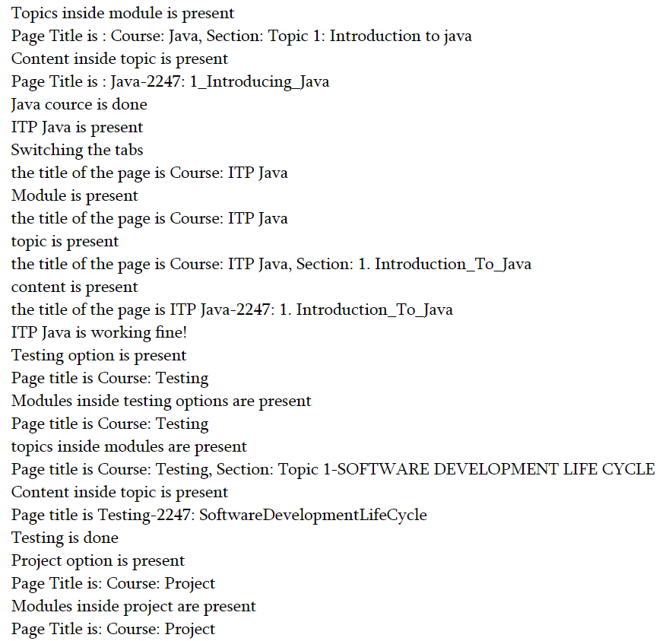
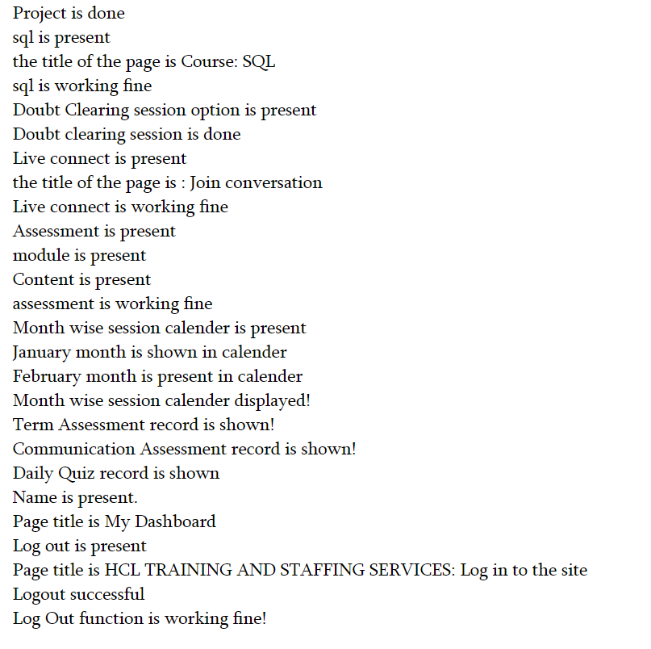
Functionalities Test Report:(Cont)

Slide 12
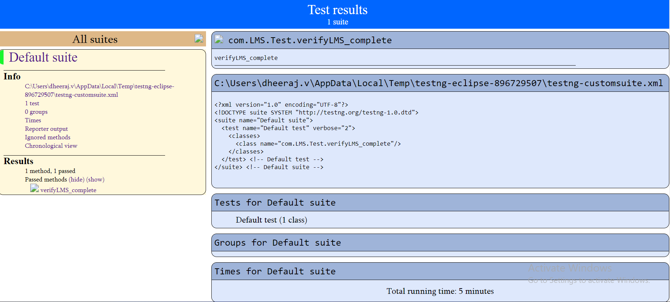
Test Results:

Slide 13
LMS Automation Scripts File:
Hyperlink for Source Code:
LMS Automation File:
LMS Testing
For Selecting a Browser:
LMS Testing\LMS_TESTING\LMS_BROWSER
For Separate functionalities:
LMS Testing\LMS_TESTING\LMS_PAGES
For Testing Functionalities:
LMS Testing\LMS_TESTING\LMS_TESTS
For Test Report:
LMS Testing\LMS_TESTING\LMS_TEST_OUTPUT
Download all the documents provided in GitHub, So that you can open it via this link.

Slide 14
ATM Application
Using Eclipse IDE
A ATM Machine Java Program is used for an electronic banking outlet that allows customers to complete basic transactions without the aid of a branch representative.

Slide 15
Description:
1. In this ATM Program in Java, it allows consumers to perform quick self-service transactions such as deposits, cash withdrawals and checking balance.
2. A ATM Machine Java Program is used for an electronic banking outlet that allows customers to complete basic transactions without the aid of a branch representative.
3. The scope of the project is to design an ATM system that will help in completely automatic banking this software is going to be designed for withdrawal and deposit of money and register the transaction in the database where the customer’s information is stored.

Slide 16
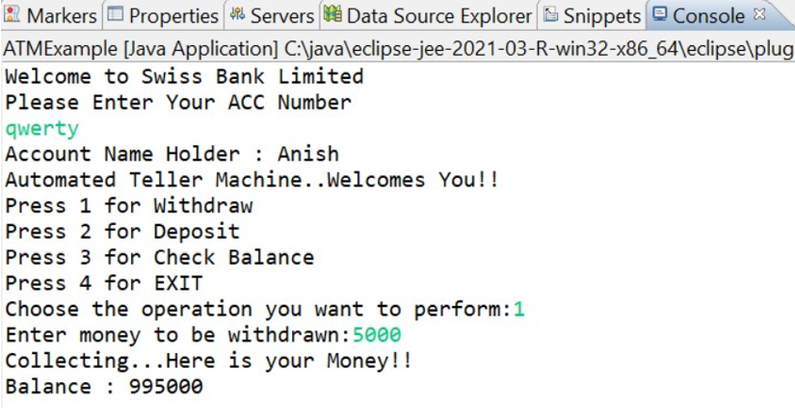
ATM Application:
Interface of Console

Slide 17

4 Functions in ATM
Withdraw
Deposit
Check Balance
4. Exit

Slide 18
Withdrawal
After entering the account number you will receive the buttons for all the functionalities.
Press 1 for withdrawal

Slide 19
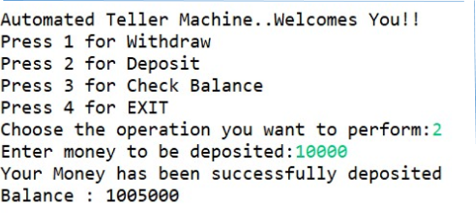
Deposit
You can deposit your money by clicking the functionality Deposit(Press 2)

Slide 20
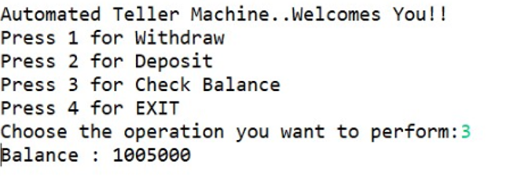
Checking Balance
You can check you balance by entering your account number and click on (Press 3) button, Which leads you to your balance amount in your account

Slide 21
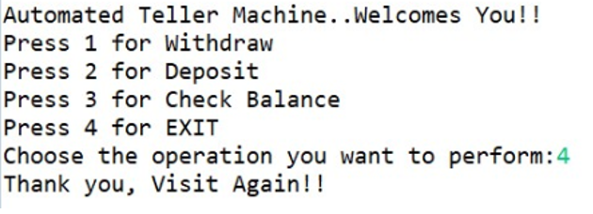
Exit
After completion of your transaction work, You need to press 4 for Closing the application

Slide 22
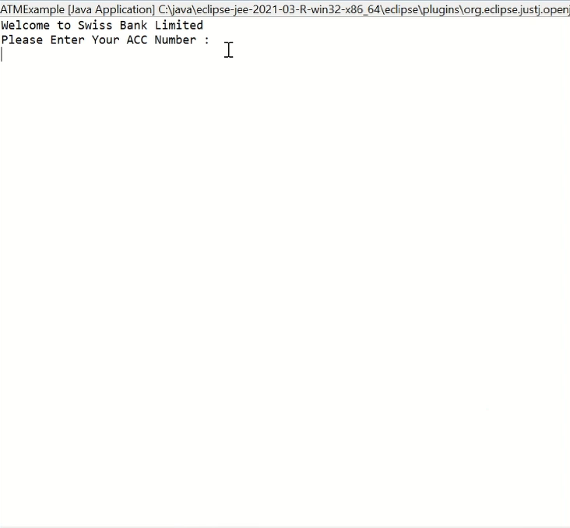
Working of Application:
ATM(Console Based)

Slide 23
Source code for this application:
USE Eclipse IDE
Download the document and use it.
ConsoleBased Application\MANUALSCRIPT_ATM.docx
Download all the documents provided in GitHub, So that you can open it via this link.

Slide 24

Manual Testing of ATM
Console Based

Slide 25
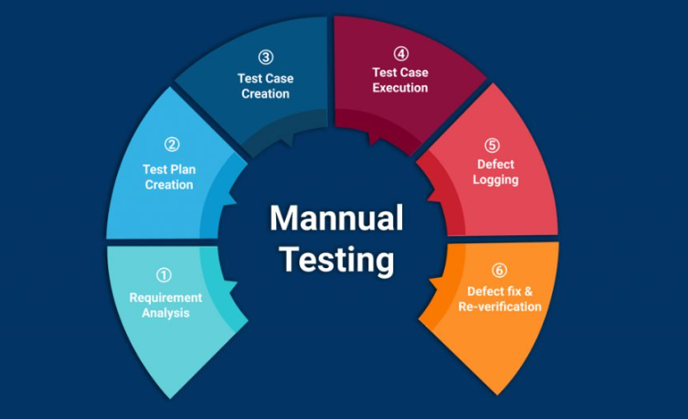
Manual Testing Documents:
1.Software Requirement Specification
ConsoleBased Application\SRS_ATM.docx
2. Test Plan Document
ConsoleBased Application\TESTPLAN_ATM.docx
3. Test Case Document
ConsoleBased Application\TESTCASE_ATM.xlsx
Download all the documents provided in GitHub, So that you can open it via this link.

Slide 26
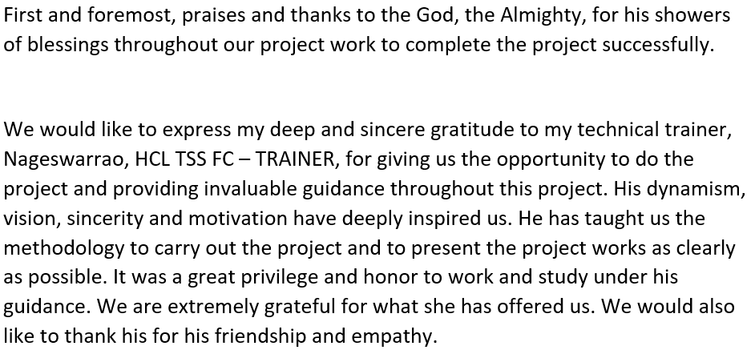
Acknowledgement:
Trainer: Nageswarrao G
Batch: ERS_COM_TESTING_3

Slide 27




Thank You!
Team IQ
9176132348
Testing@TeamIQ.com

Slide 28


MEMBERS:
1. Dheeraj V
2. Santhosh TS
3. Balaji S
4. Sujay K
5. Anish KB
6. Selvaraghavan S
Further Queries, Contact our Team.
NOTE - Download all the documents before using the hyperlinks provided in this presentation.

